Slide 1
Evaluation

Slide 2
Image #1
1_Bpk_Setyo slice 50

Slide 3
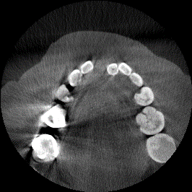



Input
Ground truth
Linkage
Previous
ME =
2.26%
2.15%
RAE =
9.49%
17.17%
Time =
2.81 s
137.12 s

Slide 4
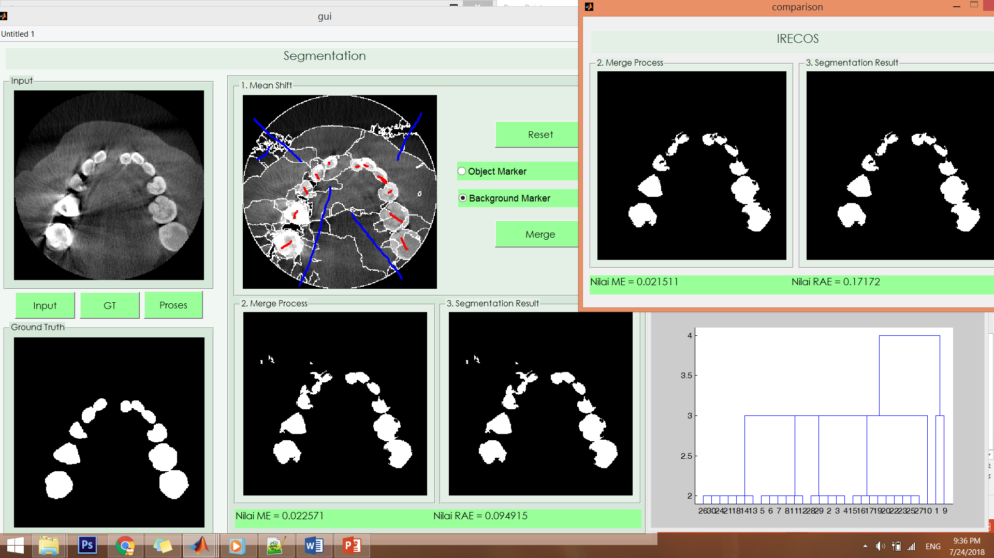

Slide 5
Image #2
1_Bpk_Setyo slice 13

Slide 6
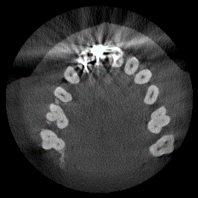



Input
Ground truth
Linkage
Previous
ME =
3.75%
3.57%
RAE =
25.70%
28.89%
Time =
3.19 s
109.70 s

Slide 7
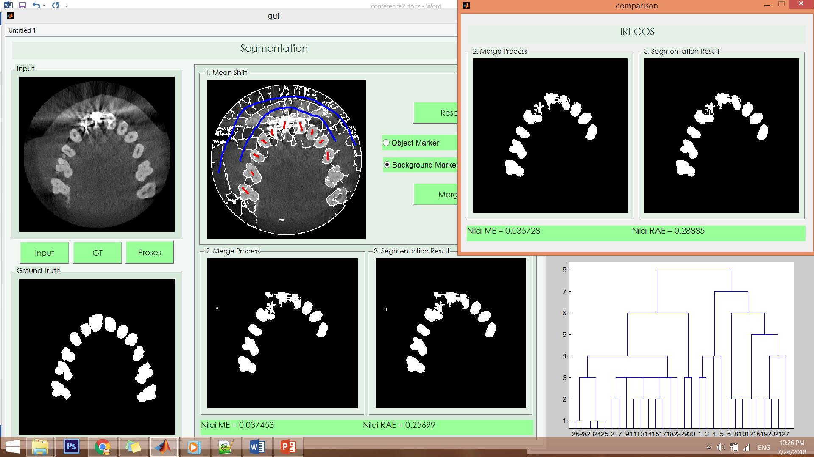

Slide 8
Image #3
2_Ibu_Erawati slice 100

Slide 9
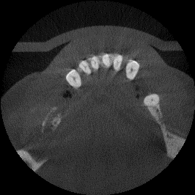



Input
Ground truth
Linkage
Previous
ME =
1.02%
1.07%
RAE =
21.84%
16.49%
Time =
0.31 s
1.40 s

Slide 10
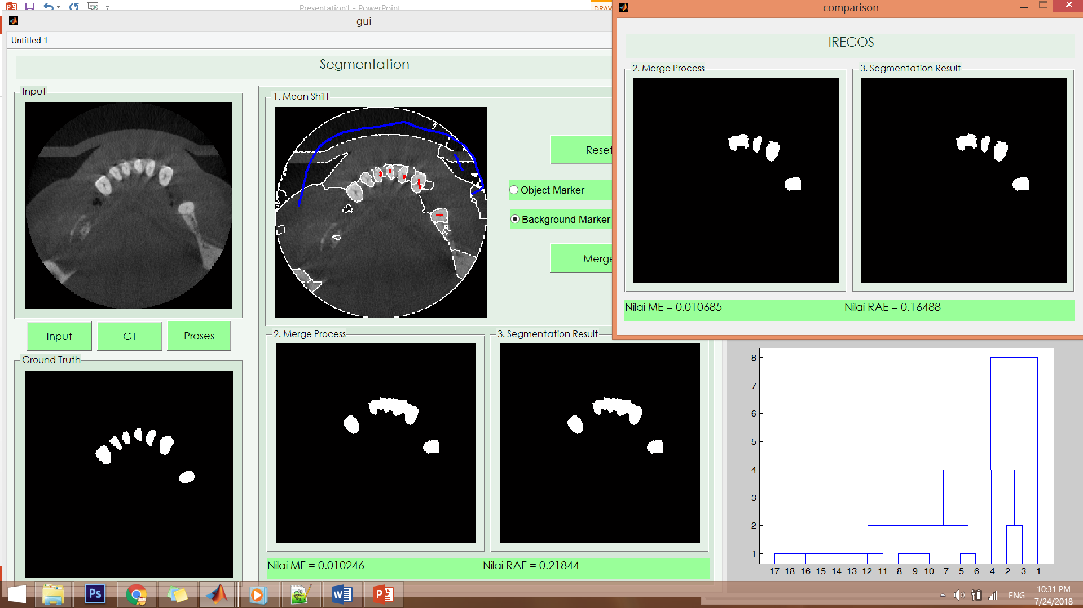

Slide 11
Image #4
3_Nn_Kartika_Afrida slice 100

Slide 12
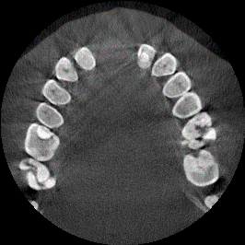



Input
Ground truth
Linkage
Previous
ME =
4.43%
4.49%
RAE =
26.85%
31.21%
Time =
2.64 s
83.70 s

Slide 13
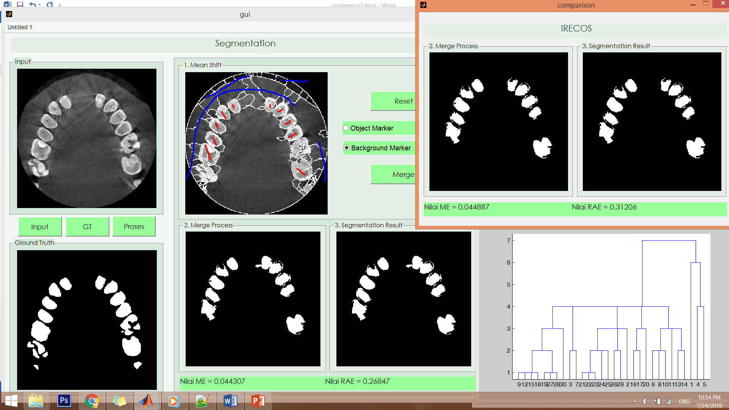

Slide 14
Image #5
3_Nn_Kartika_Afrida slice 80

Slide 15
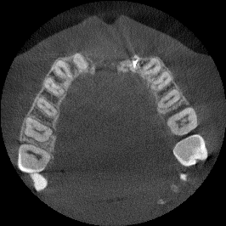



Input
Ground truth
Linkage
Previous
ME =
3.32%
2.97%
RAE =
1.67%
6.68%
Time =
1.42 s
36.90 s

Slide 16
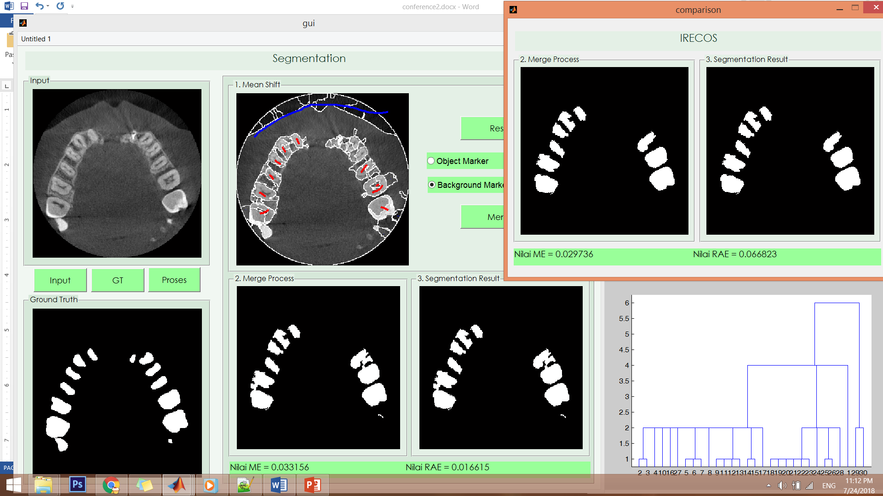

Slide 17
Image #6
4_Nn_Lydia_Lymanjaya slice 13

Slide 18
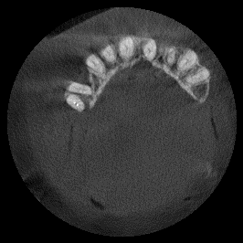



Input
Ground truth
Linkage
Previous
ME =
1.57%
2.97%
RAE =
20.25%
6.36%
Time =
0.70 s
5.06 s

Slide 19
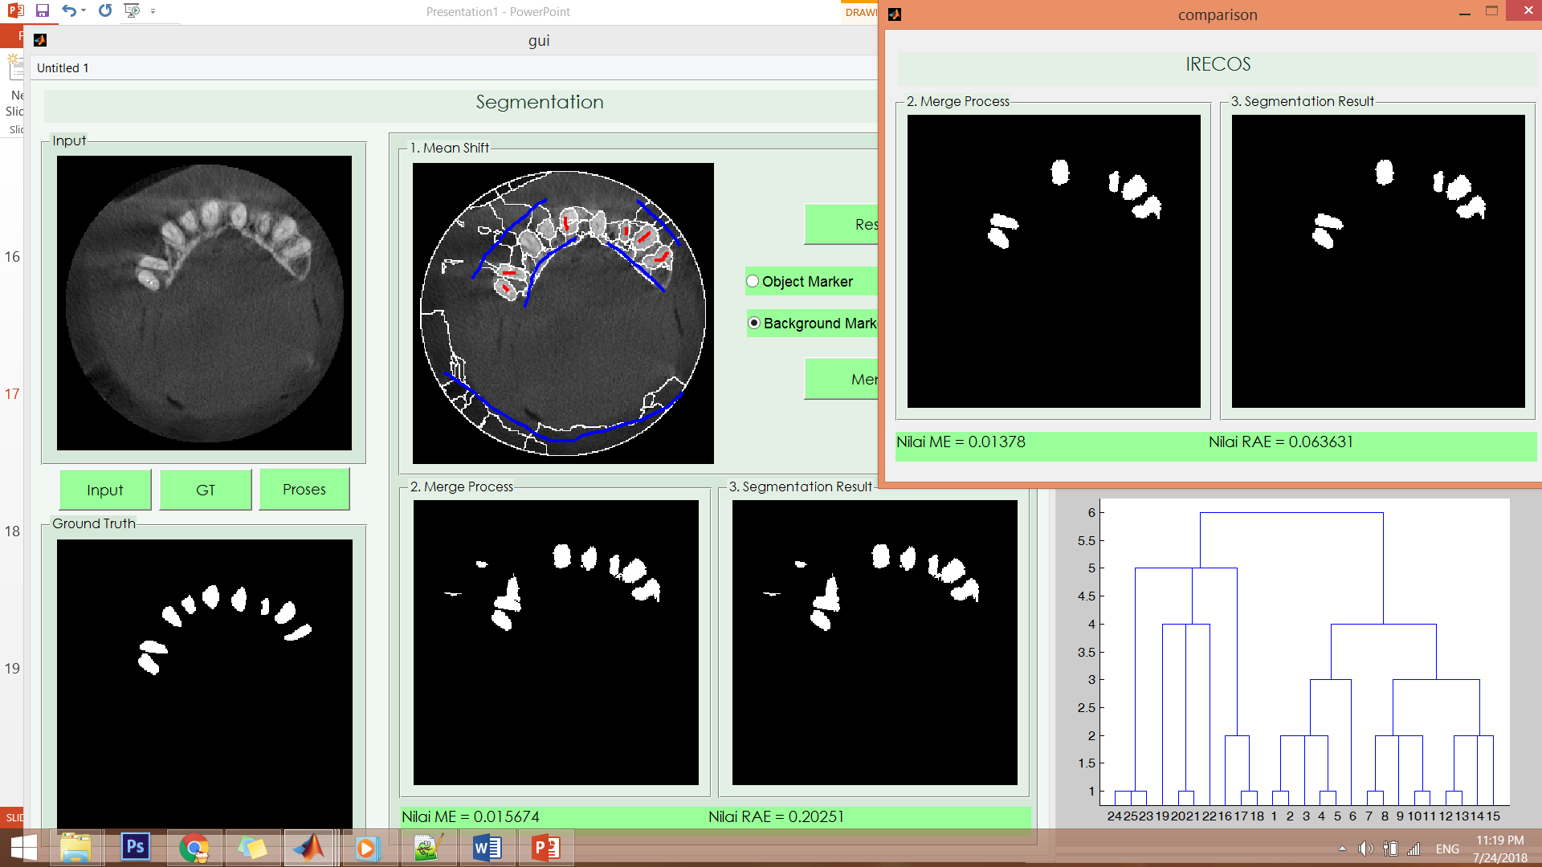

Slide 20
Image #7
5_Ny_Setiawati_Marhaeni slice 105

Slide 21
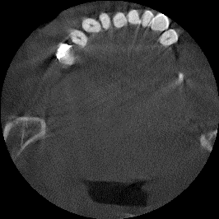



Input
Ground truth
Linkage
Previous
ME =
1.14%
1.15%
RAE =
3.88%
6.20%
Time =
0.46 s
2.23 s

Slide 22
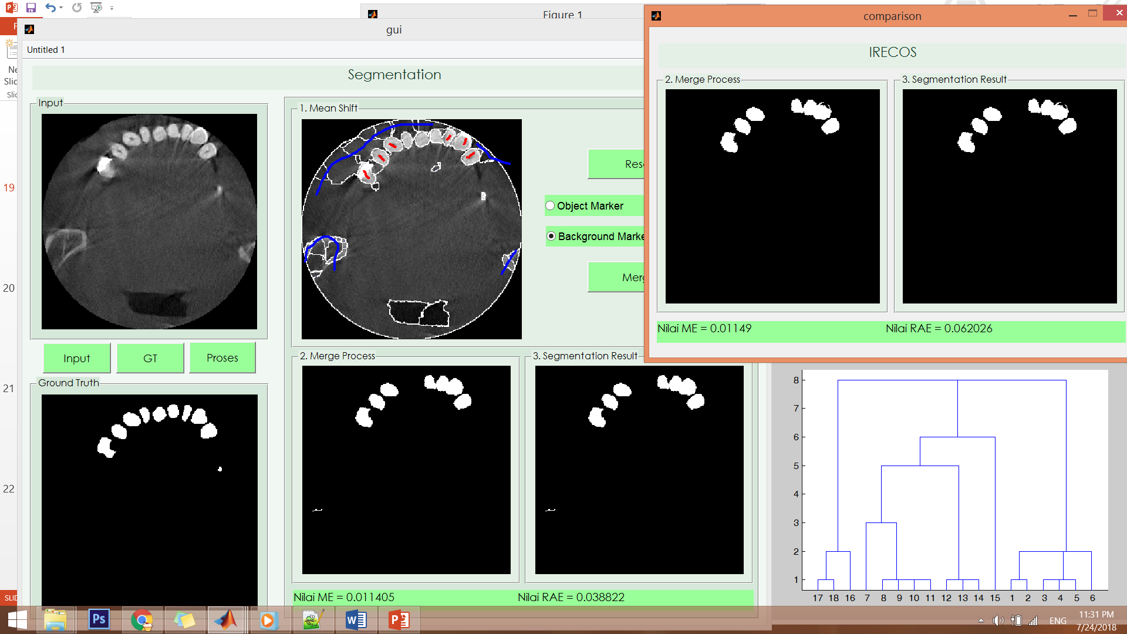

Slide 23
Image #8
6_Sandra_Dwi slice 65

Slide 24
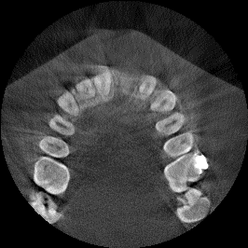



Input
Ground truth
Linkage
Previous
ME =
3.85%
3.81%
RAE =
17.11%
20.08%
Time =
1.81 s
39.72 s

Slide 25
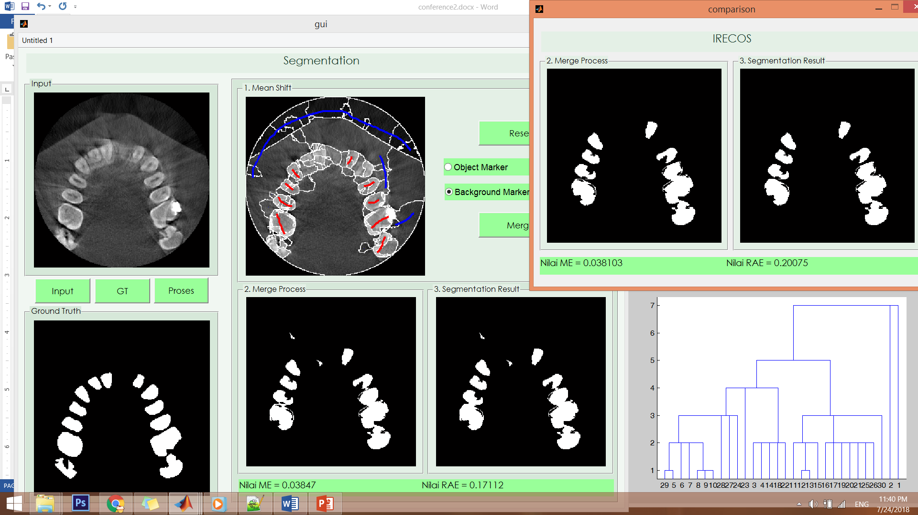

Slide 26
Image #9
7_Tn_Haryanto slice 40

Slide 27
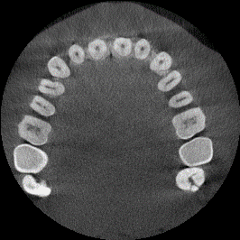

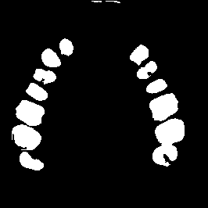

Input
Ground truth
Linkage
Previous
ME =
2.56%
2.49%
RAE =
7.48%
8.07%
Time =
0.85 s
8.44 s

Slide 28


